Slide 1

Music Genre Classification
Data science final project
GITHUB
Jonathan Haddad

Slide 2
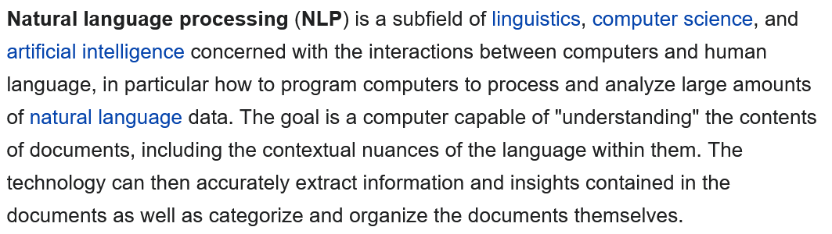
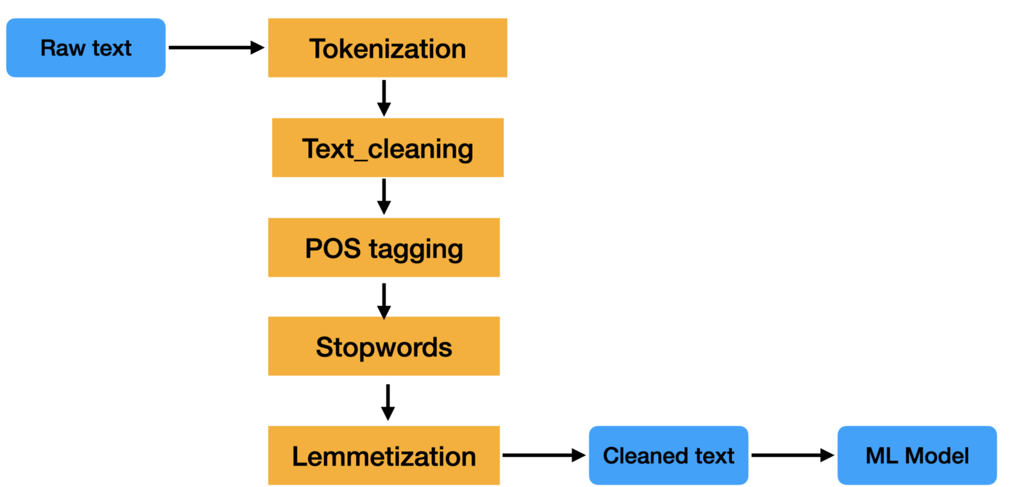

Can computers understand words and sentences?
Can we predict the genre of a song based on his lyrics?

Slide 3




4 Genres
My plan is to build a model that can classified a song from 4 different genres:
Hip hop
Rock
Reggae
soul

Slide 4

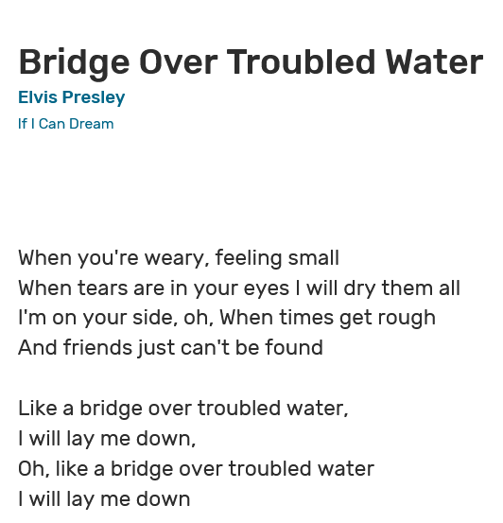
Getting the data
I crawled the data from: www.vagalume.com.br .
A great website with plenty of lyrics.
I used “Requests” and “BeautifulSoup” from python libraries to crawl the data.
After a couple of day I got close to 40,000 lyrics.

Slide 5
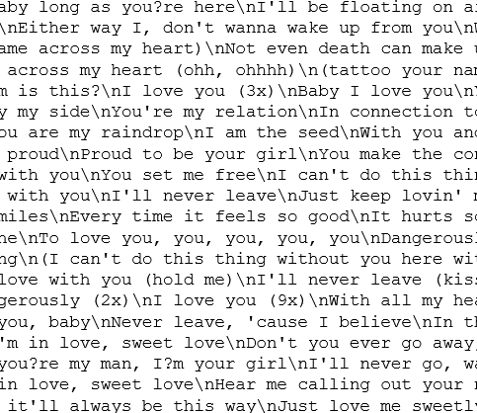

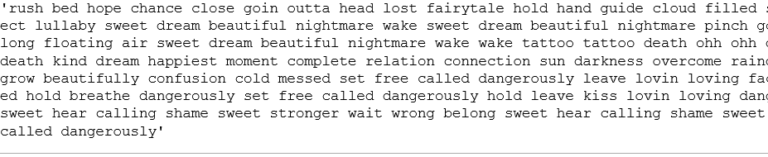
Data cleaning
I had to do a lot of cleaning from the raw data:
Language recognition.
Removing stop words.
Removing punctuation.
Removing numbers.
Word lemmatization.

Slide 6
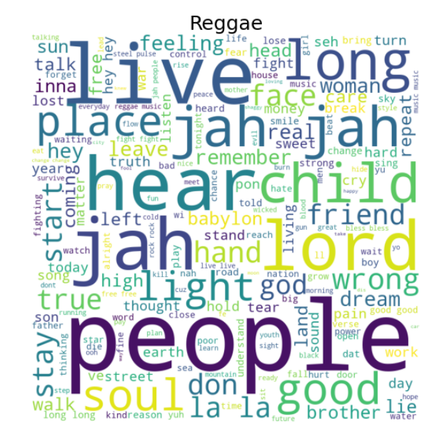
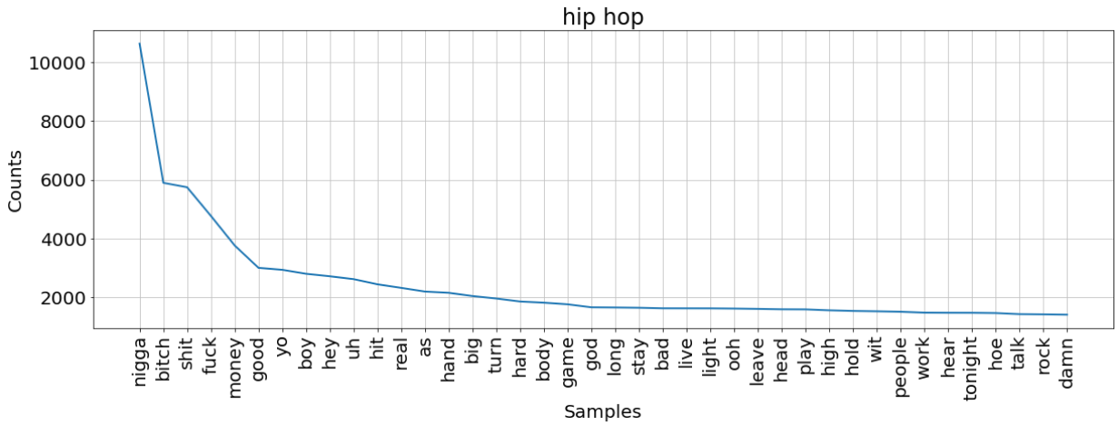
Visualization
I could get some nice plots after cleaning the data.
We can see frequent words common to specific genres.

Slide 7
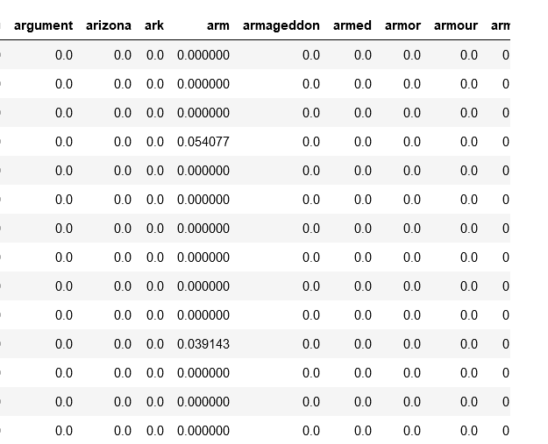

Vectorization
To train the model first I had to vectorize the corpus.
As we can see each column is represented by a word in the corpus, and each cell represent the TF-IDF (Term Frequency — Inverse Document Frequency) of a specific word from the text.

Slide 8
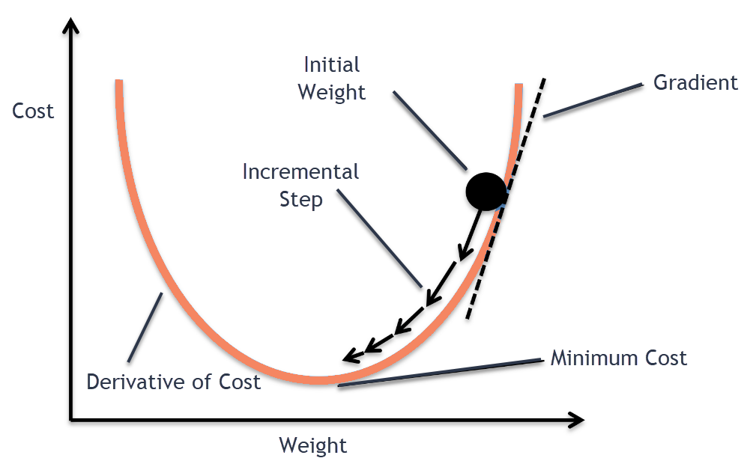
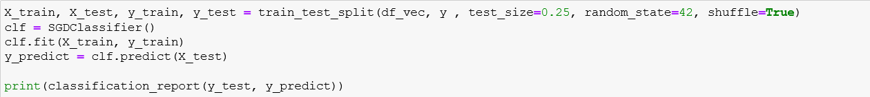
Train and Test
I use the SGD Classifier to build the model. It is a linear classifier optimized by Stochastic Gradient Descent.

Slide 9
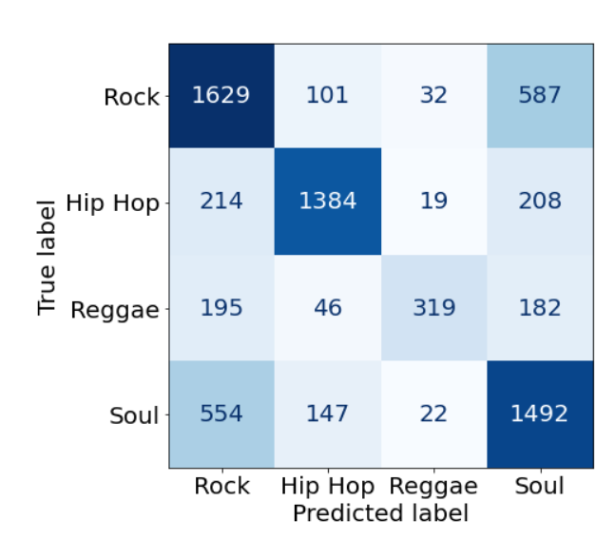
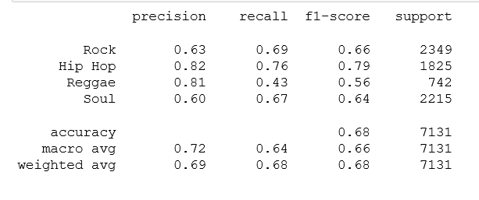
Model prediction
As we can see the overall accuracy is 0.68.
The model classified quit well hip hop and reggae music.
Between rock and soul there are some tuning to do but the precision is still above average.

